Slide 1
CPU and Memory
Operating Systems & Computer Architecture
CT049-3-1-OS&CA
Ver: VC1

Slide 2
Topics we will cover
CPU Architectures
CPU Features and Enhancements
  Fetch-Execute Timings
  Scalar and Super Scalar CPU Organization
Memory Enhancements
  Wide Path Memory
  Memory Interleaving
  Cache Memory
Multiprocessing
Design Implementations

Slide 3
Learning Outcomes
At the end of this section, YOU should be able to:
Discuss the types of CPU architectures available
Discuss the various CPU enhancement techniques used
Discuss the various Memory Enhancement techniques used

Slide 4
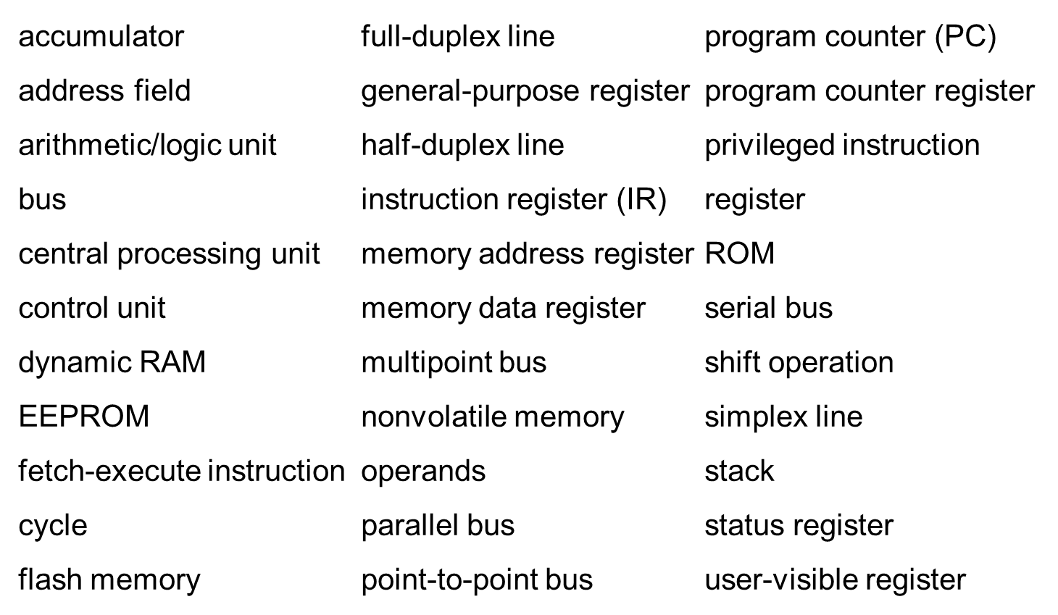
Key Terms

Slide 5
Current CPU Architectures
Current CPU Architecture Designs
  Traditional modern architectures
  VLIW (Transmeta) – Very Long Instruction Word
  EPIC (Intel) – Explicitly Parallel Instruction Computer
Current CPU Architectures
  IBM Mainframe series
  Intel x86 family
  IBM POWER/PowerPC family
  Sun SPARC family

Slide 6
Traditional Modern Architectures
Problems with early CPU Architectures and solutions:
Large number of specialized instructions were rarely used but added hardware complexity and slowed down other instructions
Slow data memory accesses could be reduced by increasing the number of general purpose registers
Using general registers to hold addresses could reduce the number of addressing modes and simplify architecture design
Fixed-length, fixed format instruction words would allow instructions to be fetched and decoded independently and in parallel
Copyright 2010 John Wiley & Sons, Inc.

Slide 7
VLIW Architecture
Transmeta Crusoe CPU
128-bit instruction bundle = molecule
  Four 32-bit atoms (atom = instruction)
  Parallel processing of 4 instructions
64 general purpose registers
Code morphing layer
  Translates instructions written for other CPUs into molecules
  Instructions are not written directly for the Crusoe CPU

Slide 8
EPIC Architecture
128-bit instruction bundle
  3 41-bit instructions
  5 bits to identify type of instructions in bundle
128 64-bit general purpose registers
128 82-bit floating point registers
Intel X86 instruction set included
Programmers and compilers follow guidelines to ensure parallel execution of instructions

Slide 9
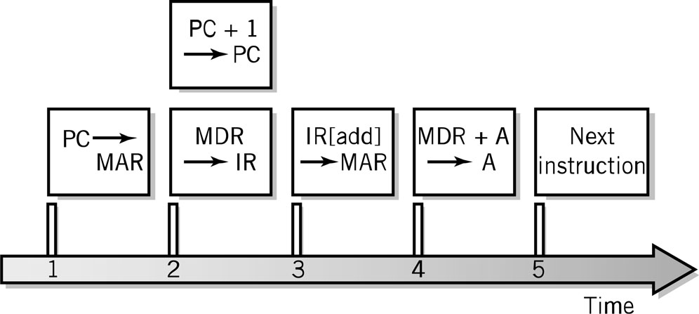
Fetch-Execute Cycle Timing Issues
Computer clock is used for timing purposes for each step of the instruction cycle
GHz (gighertz) – billion steps per second
Instructions can (and often) take more than one step
Data word width can require multiple steps
Fetch-execute timing diagram

Slide 10
CPU Features and Enhancements
Separate Fetch/Execute Units
Pipelining
Multiple, Parallel Execution Units
Scalar Processing
Superscalar Processing
Branch Instruction Processing

Slide 11
Separate Fetch-Execute Units
Fetch Unit
  Instruction fetch unit
  Instruction decode unit
    Determine opcode
    Identify type of instruction and operands
  Several instructions are fetched in parallel and held in a buffer until decoded and executed
  IP – Instruction Pointer register holds instruction location of current being processed
Execute Unit
  Receives instructions from the decode unit
  Appropriate execution unit services the instruction

Slide 12
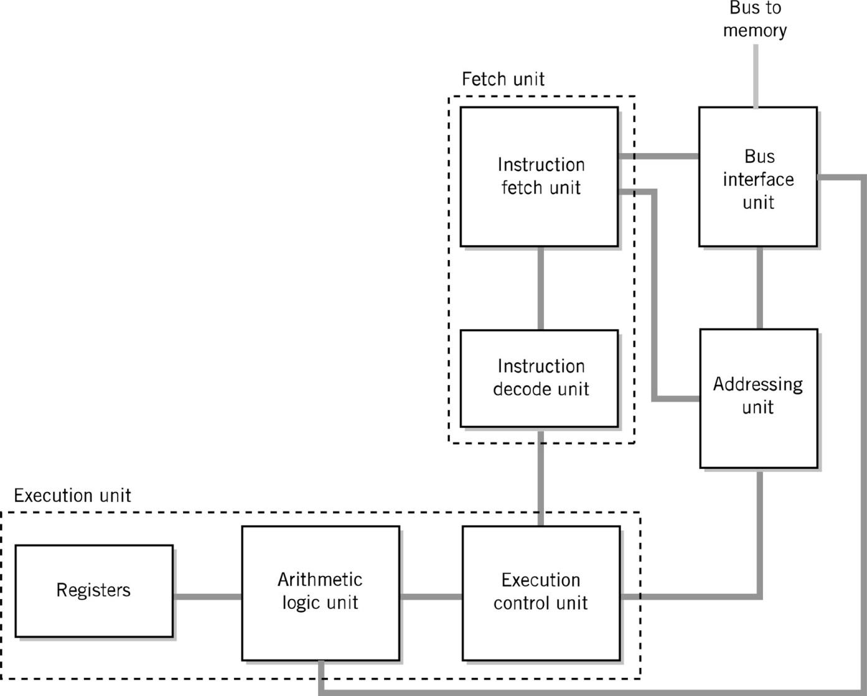
Alternative CPU Organization

Slide 13
Instruction Pipelining
Assembly-line technique to allow overlapping between fetch-execute cycles of sequences of instructions
Scalar processing
  Average instruction execution is approximately equal to the clock speed of the CPU
Problems from stalling
  Instructions have different numbers of steps
Problems from branching

Slide 14
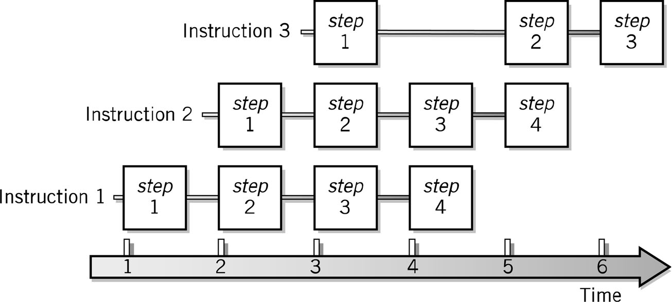
Pipelining Example

Slide 15
Multiple, Parallel Execution Units
Different instructions have different numbers of steps in their cycle
Each execution unit is optimized for one general type of instruction
Multiple execution units permit simultaneous execution of several instructions

Slide 16
Superscalar Processing
Process more than one instruction per clock cycle
Separate fetch and execute cycles as much as possible
Buffers for fetch and decode phases
Parallel execution units

Slide 17
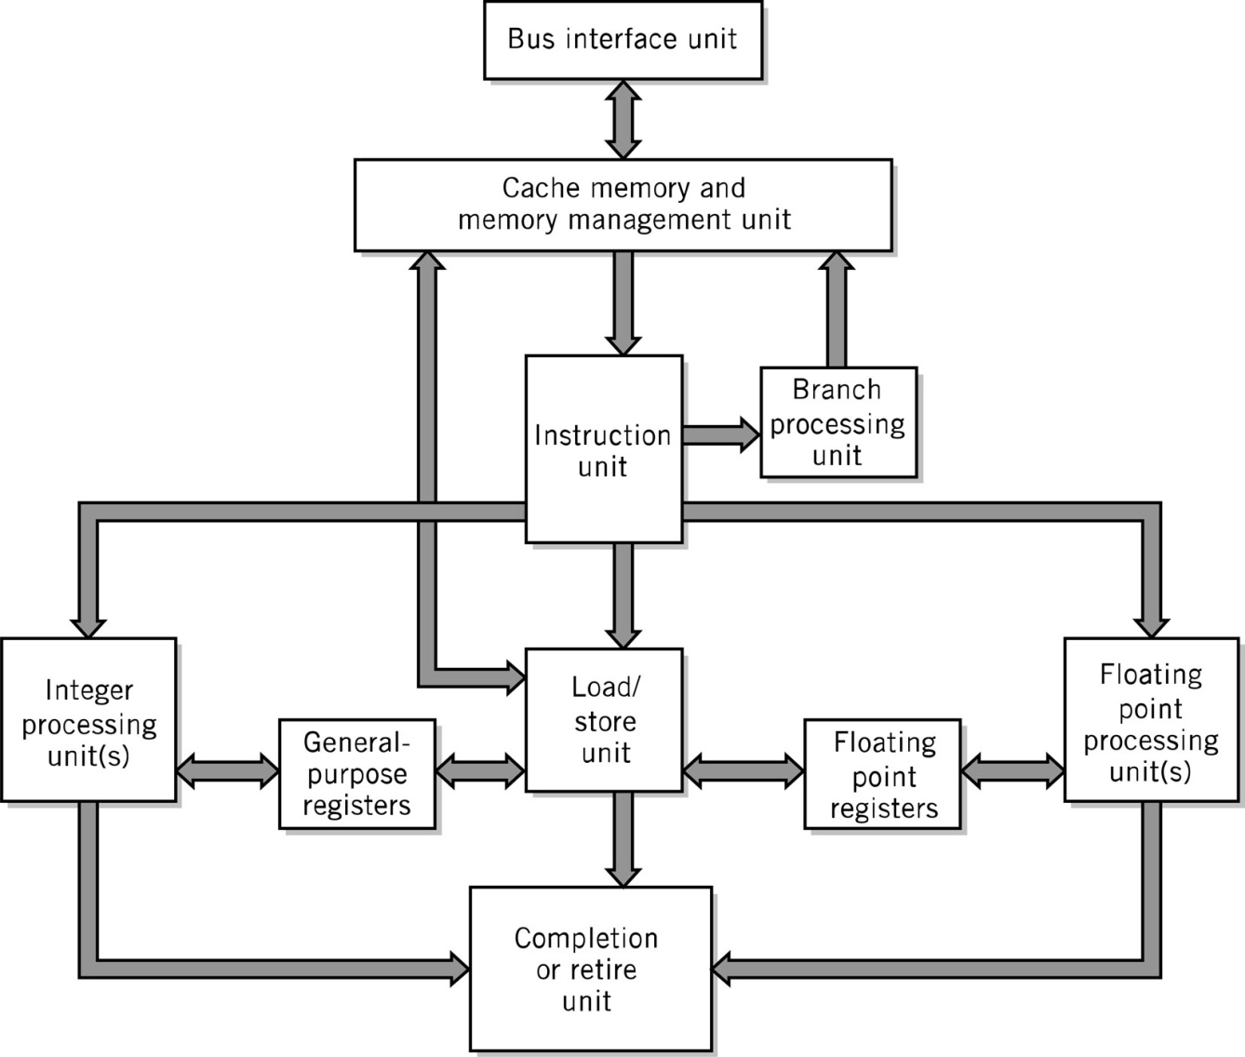
Superscalar CPU Block Diagram

Slide 18
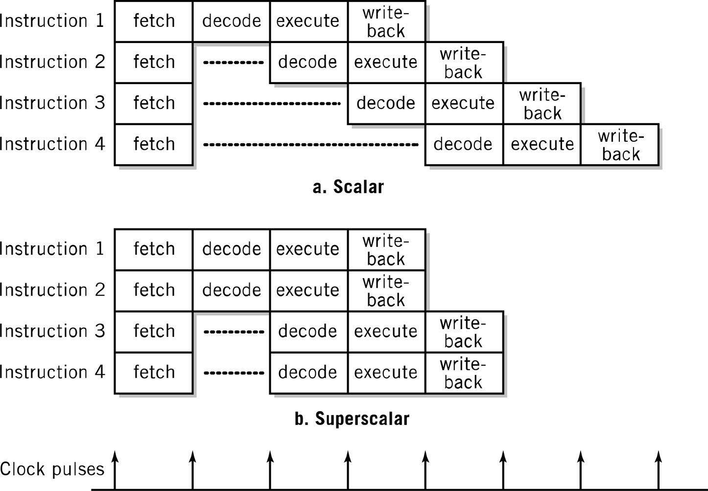
Scalar vs. Superscalar Processing

Slide 19
Memory Enhancements
Memory is slow compared to CPU processing speeds!
  2Ghz CPU = 1 cycle in ½ of a billionth of a second
  70ns DRAM = 1 access in 70 millionth of a second
Methods to improvement memory accesses
  Wide Path Memory Access
    Retrieve multiple bytes instead of 1 byte at a time
  Memory Interleaving
    Partition memory into subsections, each with its own address register and data register
  Cache Memory

Slide 20
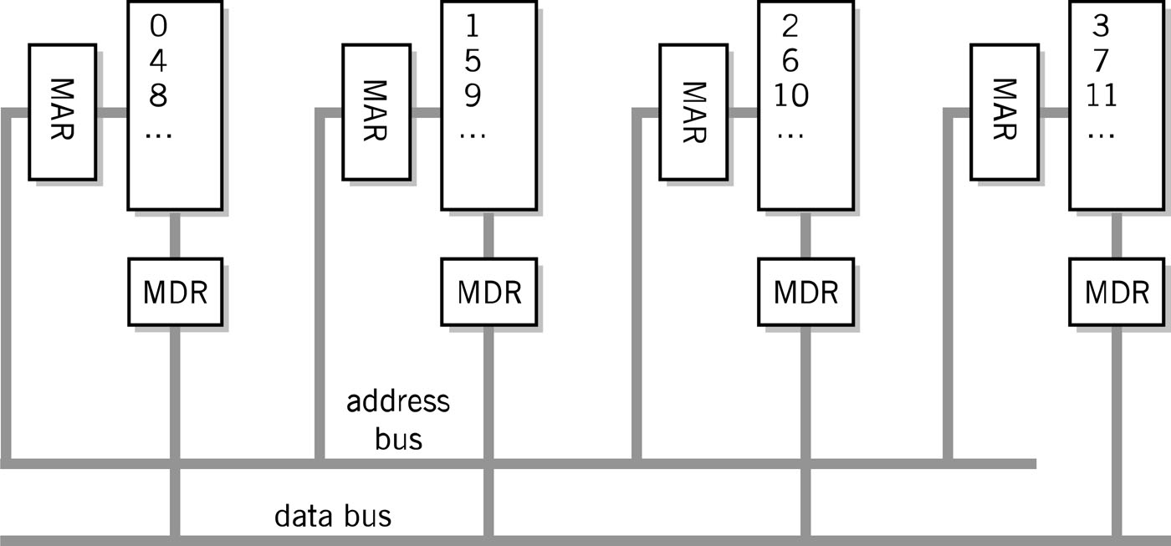
Memory Interleaving

Slide 21
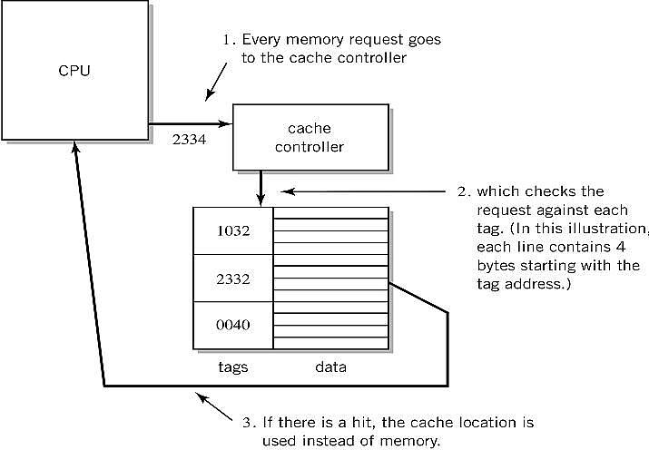
Step-by-Step Use of Cache

Slide 22
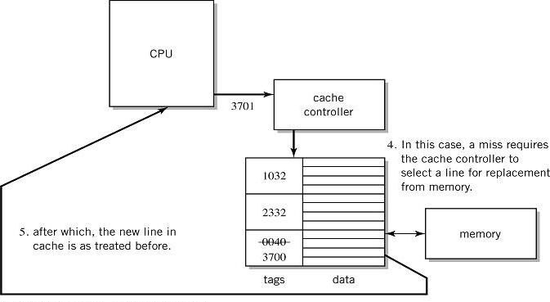
Step-by-Step Use of Cache

Slide 23
Performance Advantages
Hit ratios of 90% common
50%+ improved execution speed
Locality of reference is why caching works
  Most memory references confined to small region of memory at any given time
  Well-written program in small loop, procedure or function
  Data likely in array
  Variables stored together

Slide 24
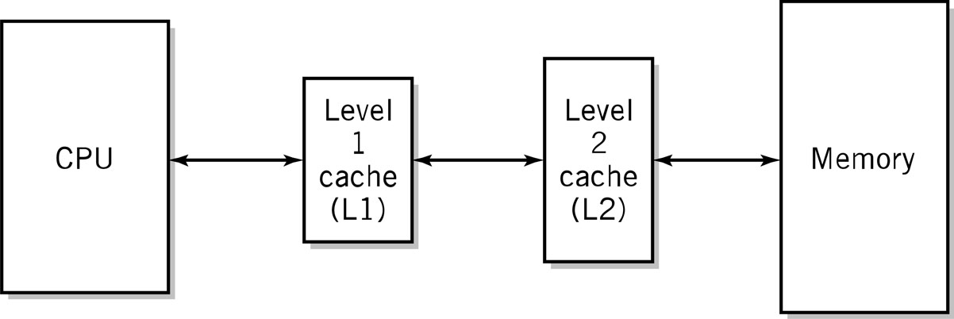
Two-level Caches
Why do the sizes of the caches have to be different?

Slide 25
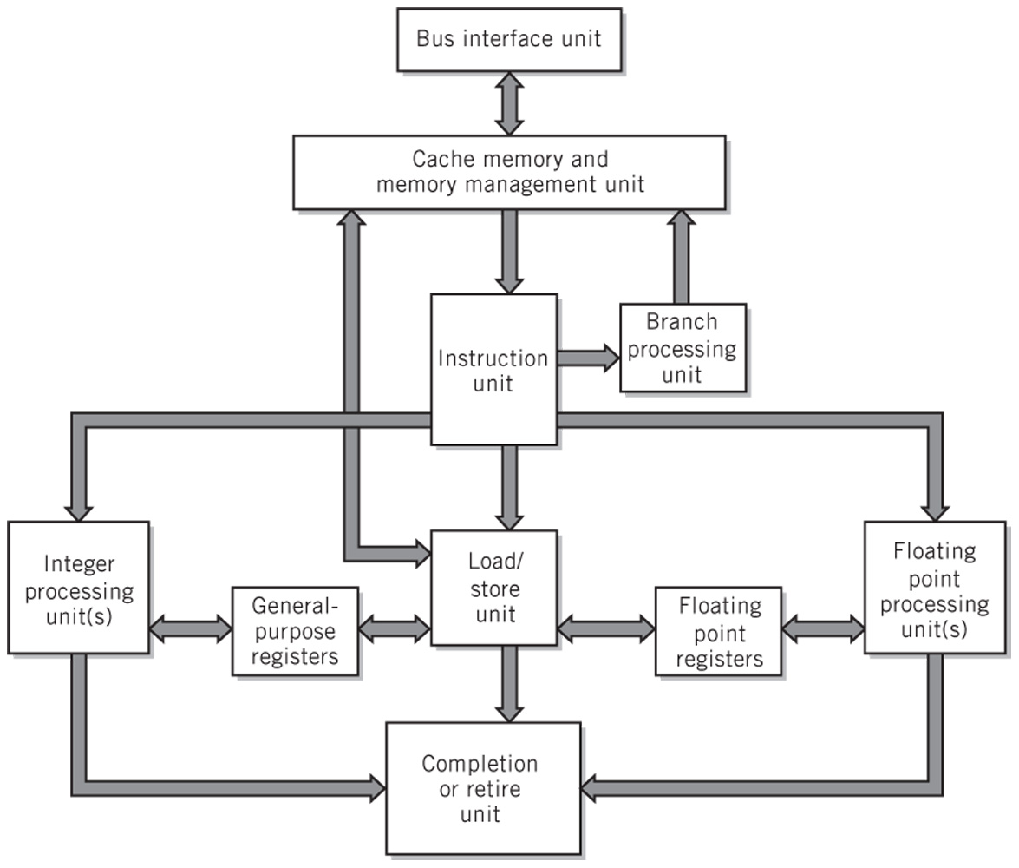
Modern CPU Block Diagram

Slide 26
Multiprocessing
Reasons
  Increase the processing power of a system
  Parallel processing
Multiprocessor system
  Tightly coupled
  Multicore processors - when CPUs are on a single integrated circuit

Slide 27
Multiprocessor Systems
Identical access to programs, data, shared memory, I/O, etc.
Easily extends multi-tasking, and redundant program execution
Two ways to configure
  Master-slave multiprocessing
  Symmetrical multiprocessing (SMP)

Slide 28
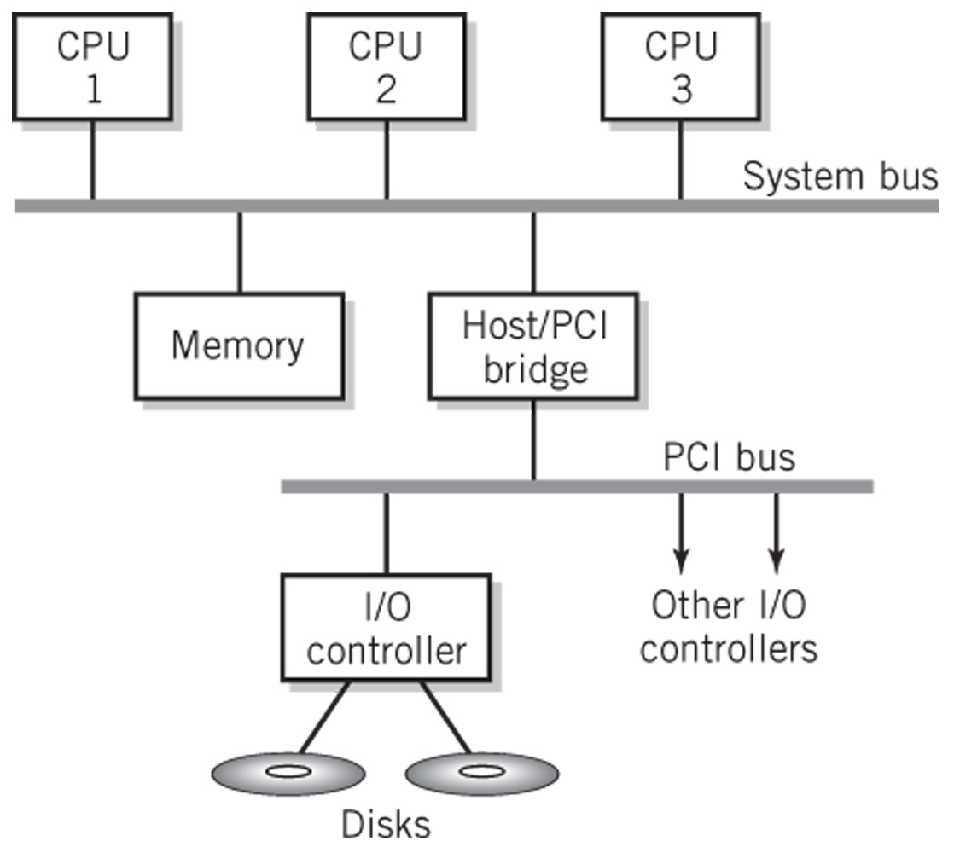
Typical Multiprocessing System
Configuration

Slide 29
Master-Slave Multiprocessing
Master CPU
  Manages the system
  Controls all resources and scheduling
  Assigns tasks to slave CPUs
Advantages
  Simplicity
  Protection of system and data
Disadvantages
  Master CPU becomes a bottleneck
  Reliability issues – if master CPU fails entire system fails

Slide 30
Symmetrical Multiprocessing
Each CPU has equal access to resources
Each CPU determines what to run using a standard algorithm
Disadvantages
  Resource conflicts – memory, i/o, etc.
  Complex implementation
Advantages
  High reliability
  Fault tolerant support is straightforward
  Balanced workload

Slide 31
Quick Review Questions
The x86 series is an example of a CPU architecture. As you are probably aware, there are several different chips, including some from different manufacturers even, that qualify as x86 CPUs. What, exactly, defines the x86 architecture? What word defines the difference between the various CPUs that share the same architecture?
Name at least one different CPU architecture.
What is the major performance advantage that results from the use of multiple general-purpose data registers?
Explain the advantage in implementing separate fetch and execute units in a CPU. What additional task is implemented in the fetch unit as a performance enhancement measure?
Explain how pipelining serves to reduce the average number of steps in the execution part of the fetch-execute cycle.
Most CPUs today are superscalar. What does that mean?

Slide 32
Summary
Functionally, the operation of the CPU, together with memory, is essentially identical to that of the Little Man Computer. For each component of the Little Man Computer, there is a corresponding component in the computer unit. Within the CPU, the most important components are registers. Data may be moved between registers, may be added or subtracted from the current contents of a register, and can be shifted or rotated within a register or between registers. Each instruction in the instruction set is executed by performing these simple operations, using the appropriate choice of registers and operations in the correct sequence for the particular instruction.
The sequence of operations for a particular instruction is known as its fetch-execute cycle. A fetch-execute cycle exists for every instruction in the instruction set. Fetch-execute instruction cycles constitute the basis for all program execution in the computer. The sequence for each instruction corresponds closely to the actions taken by the Little Man in performing a similar instruction.

Slide 33
END
Q&A

Slide 34
Next
Input & Output

